Slide 1
The VALMIN Code (2015)
Perth
12 April 2016

Slide 2
Today’s program
PM | Title
1:00 | Welcome & introduction - I Chen slides 1-3
 | Session 1 – VALMIN Code explained - D Lord slides 4-12
 | VALMIN-JORC - M Greentree slides 13-17
 | Use of Code - D Lord slides 18-23
2:40 | Afternoon tea
3:00 | Session 2 – Changes & Implications - M Greentree slides 25-28
 | Use of Code - D Lord slides 29-31
 | Reasonableness - I Chen slides 32-38
 | Use of Code - M Greentree slides 39-45
4:30 | Session 3 Questions & Answers
5:00 | Close

Slide 3
Your presenters today
Deborah Lord
Ivy Chen
Matthew Greentree

Slide 4
History Overview
WHY DID WE CHANGE THE CODE
2005 was the last update and much has changed
Guidance by ASX and ASIC has materially increased
JORC was to be and has been updated, leading to misalignment in definitions and some new concepts
Increased focus by ASIC on Exploration Targets and Production Targets
Clamp down by ASIC on what is Reasonable/ Reasonableness
Previous Code rolled together Technical Assessment and Valuation and we believed it confused what should have been clearer
We now cross reference JORC and use same definitions
We have adopted helpful guidance from SAMVAL and CIMVAL
We have used language that harmonises VALMIN to the International Valuation Standards Council (IVSC) and we commenced the process of harmonising language across all existing Codes.

Slide 5
Conventions used in this presentation
Text quoted directly from the VALMIN Code is like this [and referenced with Clause or page and paragraph like this]
VALMIN Committee comment is like this.

Slide 6
The fine print
Use and reproduction of the 2005 and 2015 VALMIN Codes, and of this presentation, is authorised by the copyright holder (the VALMIN Committee) for the purposes of disseminating and upholding the VALMIN Code
The Australian Securities Exchange (ASX) Listing Rules and Guidance Notes, and the Australian Securities and Investments Commission (ASIC) Regulatory Guides and Information Sheets, are referenced by VALMIN and are available on their respective websites.

Slide 7
More Fine print
Semicolons joins items in a list which are thematically, rather than grammatically, related. They add emphasis to subsequent clauses as an important explanations or extension of the first. This means that the second and subsequent phrases cannot be omitted from the requirements of a list, and become mandatory.
A comma, on the other hand, joins phrases which are grammatically related only. Removal of a phrase surrounded by commas (a subjunctive clause) will still make sense, which means anything surrounded by commas can be optional.
The semi-colons have therefore been placed deliberately in the Code to indicate the intent of the Code that the elements of each list where semi-colons are used are mandatory as a whole.

Slide 8
Contents Page
1. Introduction: Purpose; Context; and Scope Pages 1 - 6
2. VALMIN Practitioners: Who is a Practitioner; Requirements of Practitioners Pages 7 – 9
3. Code Principles: Competence; Materiality; Transparency Pages 11 - 12
4. Additional requirements: Reasonableness; Independence Pages 13 - 14
5. Public Report: Intent of a Public Report; Report content; Technical Assessment Report;
Valuation Report; Independent Expert Report/Specialist Report Pages 15 -18
6. Commissioning a Public Report: Written engagement; Scope; Cost; Provision of previous reports; Confidential information Pages 19 - 20
7. Technical Assessment: Study terminology; Tenure Status; Mineralisation, Mineral Resources and Ore Reserves; Mineral Extraction; Capital and Operating Costs; Revenue Pages 21-27
8. Valuation: Basis of Value; Common Valuation Approaches; Appropriate Valuation Approach; In Situ Values; Use of Ore Reserves and Mineral Resources Range; Market premium or discount. Pages 28 - 30
9. Financial Modelling: Taxation and royalties; Financing; Liabilities, commitments and financial exposures; Forecasts. Pages 31 - 32
10. Risks and opportunities: Page 33
11. Other: Site inspection; Draft reports; Records; Indemnities; Declarations Pages 33 - 35
12. Standard: Professional Organisation; Qualifications and Organisations; Corporation and licences; Sign-off. Page 36
13. Acronyms Page 37
14. Definitions Pages 38 – 40
15. Glossary Pages 41- 42

Slide 9
SESSION 1
The VALMIN Code explained
What is the VALMIN Code?
How does VALMIN fit with JORC?
When and by whom is the VALMIN Code used?
What is the VALMIN Code used for?

Slide 10
What is the VALMIN Code?
The VALMIN Code is the Australasian Code for public reporting of technical assessments and valuation of mineral assets
VALMIN provides guidance on matters that may be subject to Australian regulations, other provisions of law and the published policies and guidance of the Australian Securities and Investments Commission (ASIC) and the Listing Rules of the Australian Securities Exchange (ASX) or of other relevant securities exchanges. [p3 para 3]

Slide 11
What was the process of engagement?
The VALMIN Seminar Series (Perth 2011, Brisbane 2012) raised awareness of VALMIN and regulatory changes at that time (RG111, 112, JORC Code 2012, ASX Listing Rules 2012)
In November 2013 a draft Code, incorporating feedback from the VALMIN Seminar Series, was issued for comment to key stakeholders including AIG, AusIMM, MCA, ASX, ASIC and PESA
The public Exposure Draft Code was released in April 2015 including feedback from key stakeholders on the previous draft Code. This was followed by a webinar explaining the proposed changes to the VALMIN 2005 Code
The Exposure Draft was altered to address changes suggested during the exposure process, then there was a final round of consultation with ASX and ASIC which led to some additional revisions to this Penultimate Draft Code
The AusIMM and AIG approved the Final Version in December 2015 for release
A roadshow will be run in major centres in the first half of 2016.

Slide 12
Why are there changes in the new Code?
Changes in the regulatory framework necessitated significant restructuring of the VALMIN Code
The VALMIN Code (2015) Principles and Definitions are now consistent with JORC
International comity (reciprocal legal recognition)
Clarity of the definition of Expert. The Corporations Act defines an Expert and ASIC RGs provide guidance on Expert Reports.
ASIC RGs define an Expert as an entity that holds an Australian Financial Services Licence (AFSL). For clarity the VALMIN Code now uses the term Specialist for an expert who does not possess an AFSL.
Petroleum related clauses are changed from ‘mandatory’ to ‘guidance’ due to the mineral centric nature of VALMIN.

Slide 13

How does VALMIN fit with JORC?
The VALMIN Code provides a set of fundamental principles (Competence, Materiality and Transparency), mandatory requirements and supporting recommendations accepted as representing good professional practice to assist in the preparation of relevant Public Reports on any Technical Assessment or Valuation of Mineral Assets. It is a companion to the Australasian Code for Reporting of Exploration Results, Mineral Resources and Ore Reserves (JORC Code). [p3 para 3]
The VALMIN Code is written from a Minerals perspective and uses terminology consistent with the JORC Code. [p3 para 4]

Slide 14
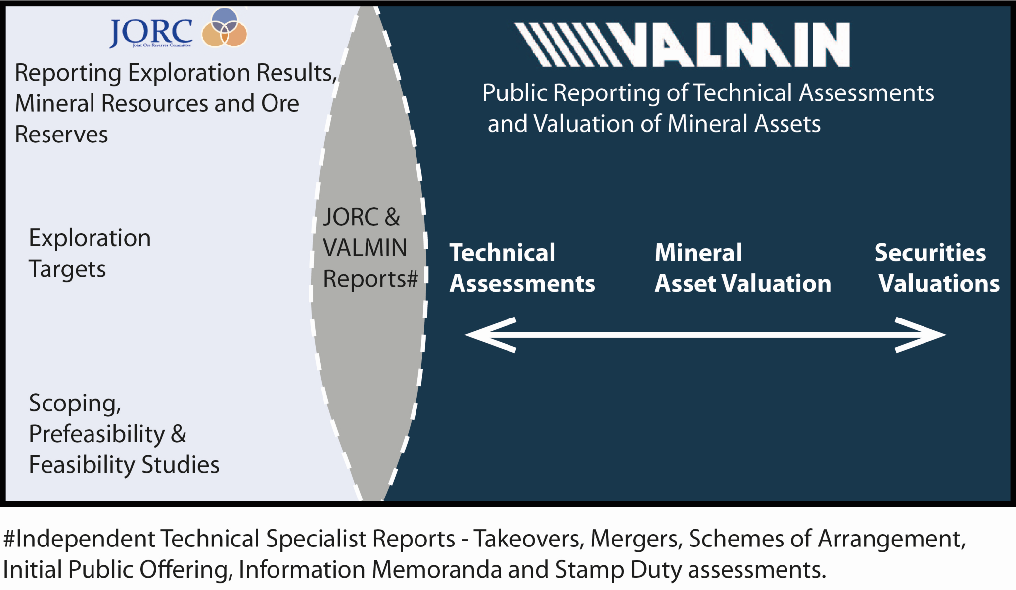
JORC - VALMIN Interaction

Slide 15
Key defined terms
(underlined where defined differently to JORC)
Public Report means a report prepared for the purpose of informing investors or potential investors and their advisers when making investment decisions, or to satisfy regulatory requirements. It includes, but is not limited to, Annual Reports, Quarterly Reports, press releases, Information Memoranda, Technical Assessment Reports, Valuation Reports, Independent Expert Reports, website postings and Public Presentations. Also see Clause 5 for guidance on Public Reports.
Technical Assessment Report involves the Technical Assessment of elements that may affect the economic benefit of a Mineral Asset.
Valuation Report expresses an opinion as to monetary Value of a Mineral Asset but specifically excludes commentary on the value of any related Securities.
Independent Expert Reports are defined with reference to ASIC Regulatory Guides.

Slide 16
Public report
Examples
Technical Assessment and Valuation for inclusion in an Independent Expert Report, typically used in a Scheme of Arrangement
Technical Assessment Report to be included in a Prospectus used during Initial Public Offering (IPO).

Slide 17
‘Non-public’ VALMIN Reports
Primary purpose is not to inform the investing public or their advisors
Technical Assessment and Valuation to advise Board for internal company purposes
Technical Assessment Report to advise Company for internal company purposes
Government reports e.g. stamp duty assessment for Office of State Revenue, Environmental Impact Statement (EIS) coal inventory reports
Expert witness reports

Slide 18
When and by whom is the VALMIN Code used?
Effective 30 January 2016
Mandatory for AusIMM and AIG members from 1 July 2016 [Cover]
As of 1 July 2016, this version of the VALMIN Code is binding on Members of the AusIMM and AIG. Members of Recognised Professional Organisations may be bound by VALMIN or a compatible code. [p8 para1]

Slide 19
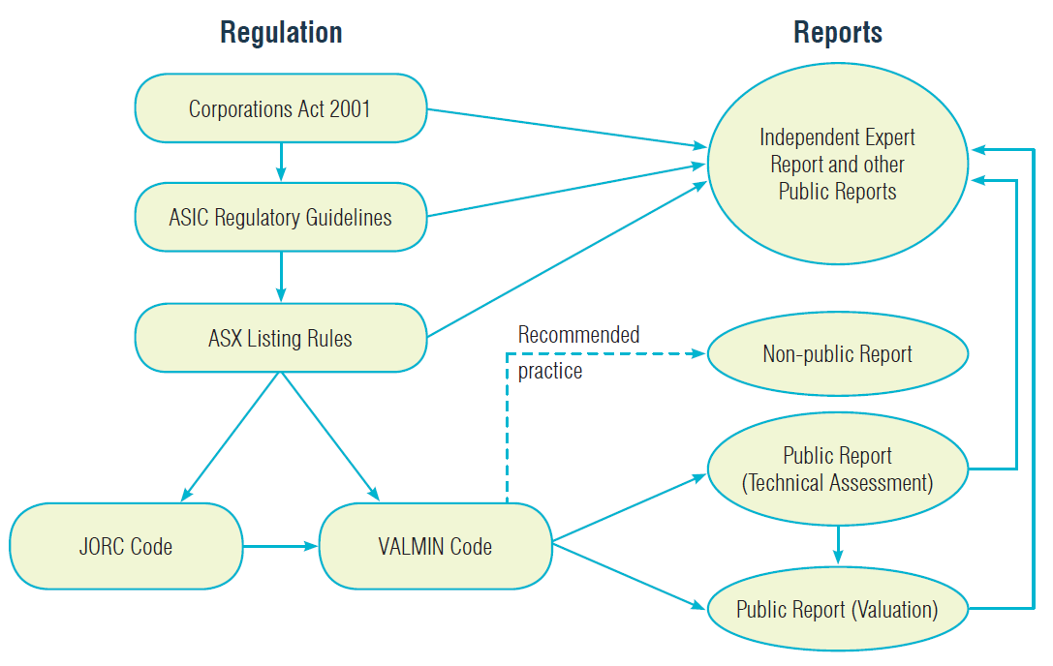
Figure 1 General relationship between VALMIN, Public Reports and Regulations

Slide 20
What is the VALMIN Code used for?
The VALMIN Code (2015) must be complied with if a Technical Assessment Report or a Valuation Report is released as a Public Report.
The JORC Code (2012) must be complied with for Public Reporting of Exploration Results, Mineral Resources and/or Ore Reserves.

Slide 21
Public Reports and other reports
Public Reports must comply
Other reports may become Public Reports at some stage so adherence to the VALMIN Code is recommended as best practice.

Slide 22
What about the Corporations Act and ASIC?
The VALMIN Code applies in any particular circumstance only if, and to the extent that, it is not inconsistent with the Corporations Act or other provisions of Australian law, ASIC policy and guidance, the ASX Listing Rules and guidance or the requirements of the relevant recognised Securities exchange. [Clause 1.3, para 2]
Simply put, the VALMIN Code is subordinate to the Corporations Act (2001), ASIC policy and guidance, and (if a company is listed) the rules of the relevant exchange.

Slide 23
Compliance with ASIC
RG 55 – Statements in Disclosure Documents and PDSs*: Consent to Quote,
RG 111 – Content of Expert Reports,
RG 112 – Independence of Experts,
RG 170 – Prospective Financial Information,
RG 228 – Prospectuses: Effective disclosure for retail investors,
RG 230 – Disclosing non-IFRS** financial information,
ASIC Class Orders CO 07/428 and 429 – Consent to Quote, and
ASIC Information Sheet (INFO 214) – Mining and resources – Forward-looking statements. Refer to http://www.asic.gov.au/regulatory-resources/takeovers/forward-looking-statements/mining-and-resources-forward-looking-statements/
* PDS = Public Disclosure Statement
** IFRS = International Financial Reporting Standards
Refer to http://www.asic.gov.au for further information and recent updates.

Slide 24


What about the ASX Listing Rules ?
2015 VALMIN Code Seminar and Webinar
We will now take a short break
2:40 – 3:00 pm (AWST, UTC +8)
If you have any questions for the presenters please email: VALMINwebinar@gmail.com
The ASX Listing Rules set out the requirements for corporations to be listed on the ASX. The ASX Listing Rules include:
continuous disclosure obligations, which require companies to immediately notify the ASX of any information that may affect the share price of the company,
rules governing how new share issues must be carried out,
guidance as to how share registries and registration should be maintained, and
specific reporting requirements for mining companies, under Chapter 5 which references the JORC Code (see ASX Guidance Note 31, and ASX Mining Reporting FAQ)
In addition to the ASX Listing Rules, the ASX provides guidance through its regularly updated Guidance Notes and FAQs (frequently asked questions).
For further information refer to http://www.asx.com.au .

Slide 25
SESSION 2
Changes and implications
The revised VALMIN Code (2015)
What are the changes?
What do you need to do?

Slide 26
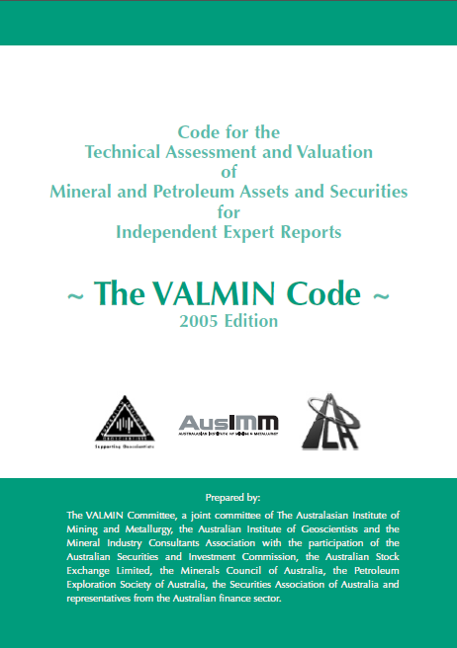
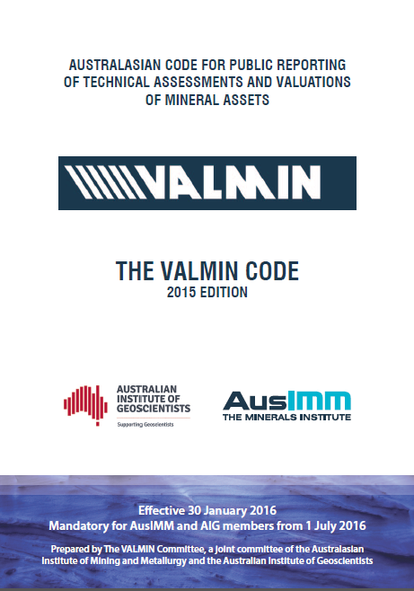
The 2005 and 2015 Codes

Slide 27
Key Changes
Independence
New definitions of value
Use of Ore Reserves and Mineral Resources (Clause 8.5)
Reasonable(ness)
Oil and Gas
Table 1 and Declarations.

Slide 28
What are the key changes?
The VALMIN Code (2015) is now aligned with the three Principles of the JORC Code, namely Competence, Materiality and Transparency. Further to the Code Principles, additional requirements are Reasonableness and Independence. [Clause 4]
The requirements of Technical Assessments are separated from the requirements of Valuation Reports; this allows for a more succinct document that reflects its dual purpose
The terms and definitions are in greater alignment with those of the JORC Code, ASIC and IVSC.
It provides guidance on additional reporting requirements, such as the Corporation Act, ASIC’s regulatory guidelines and the ASX listing rules
Petroleum technical assessments and valuations may use the VALMIN Code as guidance, but it is not mandatory.

Slide 29
Independence
The requirement for Independence has not been removed – the Principles are now consistent with JORC, with additional requirements for ‘Reasonableness’ and ‘Independence’
Independence or being Independent requires that there is no present or contingent interest in the Mineral Asset(s), nor is there any association with the Commissioning Entity or related parties that is likely to lead to bias.
Where the legal definition of Independence or Independent differs from the above, the legal definition takes precedence. [Clause 4.2a]
The Corporations Act and ASIC RGs define those transactions where independence is required, e.g. Vendor Consideration.

Slide 30
New definitions of Value
Technical Value remains unchanged but links intent to IVSC Investment Value:
  Technical Value is an assessment of a Mineral Asset’s future net economic benefit at the Valuation Date under a set of assumptions deemed most appropriate by a Practitioner, excluding any premium or discount to account for market considerations. [Clause 8.1]
  Investment Value means the benefit of an asset to the owner or prospective owner for individual investment or operational objectives. [Definitions]

Slide 31
Market Value
To align with the IVSC, Fair Market Value becomes Market value.
  Market Value is the estimated amount (or the cash equivalent of some other consideration) for which the Mineral Asset should exchange on the date of Valuation between a willing buyer and a willing seller in an arm’s length transaction after appropriate marketing where the parties had each acted knowledgeably, prudently and without compulsion. [Clause 8.1]
  IVSC has cooperative protocols with IFRS accounting standards.

Slide 32
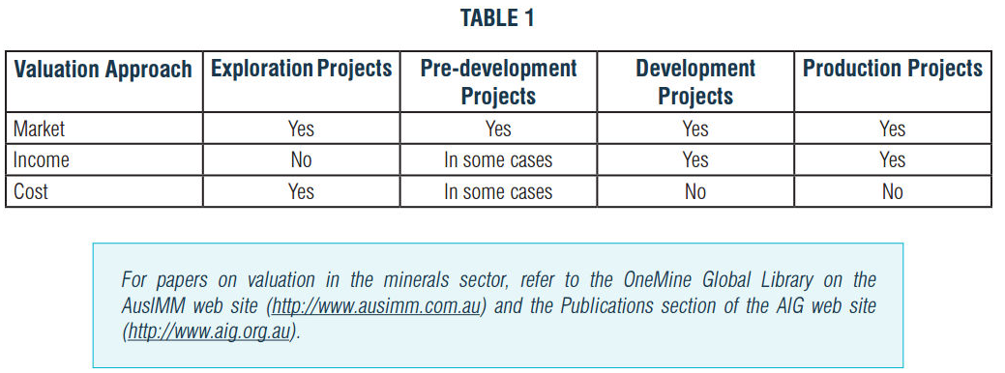
New guidance on Valuation Approach

Slide 33
Use of Ore Reserves and Mineral Resources
All Ore Reserves and Mineral Resources must be considered in a Technical Assessment or Valuation. When the Reasonable Grounds Requirement has been met for a Valuation, it is generally acceptable to use all Proved and Probable Ore Reserves in the Income Approach. It may sometimes be appropriate to include other classifications, but these must, subject to the Reasonableness Test:
  (a) meet the minimum reporting requirements of the ASX Listing Rules and guidance, the ASIC Regulatory Guidelines and guidance, and the JORC Code;
  (b) not include Exploration Targets that have not been converted to Production Targets;
  (c) be scheduled for extraction behind Proved and Probable Ore Reserves, where practical to do so;
  (d) include a statement by the Specialist that confirms the appropriateness of the Modifying Factors along with a description of their level of certainty relative to those of a Feasibility Study or Pre-Feasibility Study; and
  (e) be discounted in a manner that is commensurate with the increased uncertainty. [Clause 8.5]

Slide 34
What is Reasonable?
Reasonableness implies that an assessment which is impartial, rational, realistic and logical in its treatment of the inputs to a Valuation or Technical Assessment has been used, to the extent that another Practitioner with the same information would make a similar Technical Assessment or Valuation. Also see Clause 4.1 for guidance on Reasonableness and Reasonableness Test.
Reasonable Grounds Requirement has the meaning referred to in sections of the Corporations Act and sections of the Australian Securities and Investments Commission Act 2001 that require statements about future matters to be based on reasonable grounds (as of the date of making the statement) or else they will be taken to be misleading.
Reasonableness Test is defined in clause 4.1(b). [all from Definitions p39]

Slide 35
The ‘reasonable basis’ principle
Where a Public Report includes information relating to forecast revenue, it must set out a reasonable basis for price-related assumptions applying to any product(s) derived from the Mineral Asset. [Clause 7.6a, para 2]
This differs for each specific circumstance
It can be tested in courts
Guidelines as to what might be considered ‘reasonable basis’ are broadly provided in the VALMIN Code (2015) but practitioners are referred to Clause 8.3 for many sources of literature on valuation in the minerals sector.

Slide 36
Oil and gas
Petroleum Resources Management System The SPE-PRMS is the petroleum industry’s global standard for resource and reserve classification and reporting. SPE-PRMS is referenced in Chapter 5 of the ASX Listing Rules, and Public Reports concerning petroleum exploration, resources or reserves must be prepared in accordance with that system. [Clause 1.2e]
PESA is unable to comply with the RPO requirement and because SPE is a world-wide organisation it will not mandate the use of the VALMIN Code.

Slide 37
New terms in VALMIN Code (2015)
A Practitioner is an Expert as defined in the Corporations Act, who prepares a Public Report on a Technical Assessment or Valuation Report for Mineral Assets or Securities. This collective term includes Specialists and Securities Experts.
The following categories of Expert are recognised and are broadly aligned with ASIC Regulatory Guide 112:
  Specialists are persons whose profession, reputation and relevant industry experience in a technical discipline (such as geology, mine engineering or metallurgy) provides them with the authority to assess or value Mineral Assets, and who prepare and accept responsibility for a Public Report.
  Securities Experts are persons whose profession, reputation or experience provides them with the authority to assess or value Securities, and who prepare and accept responsibility for a Public Report. [Clause 2]
  AND note that …

Slide 38
Licences are required where securities (shares) are valued
Where a Securities Expert participates in a Valuation of, or is seen to be providing advice in relation to, Mineral Securities (as opposed to the valuation of the underlying related Mineral Assets) or provides a Vendor Consideration Opinion, they must hold appropriate financial licences. In Australia, this is an AFSL as required by Chapter 7 of the Corporations Act. [Clause 2.2, p10 para 6]
Securities Experts are required to hold an Australian Financial Services Licence (RG 111.121)
A Vendor Consideration Opinion is an opinion about the value of the shares or financial instruments being offered by the Vendor as part of the proposed transaction.

Slide 39
New definitions
Materiality now reflects the JORC Code (2012) definition:
  Material/Materiality^{D16} means that: (a) the contents and conclusions of a Report; (b) any contributing assessment, calculation or the like; and (c) data and information are of such importance that their inclusion or omission from a Technical Assessment or Valuation may result in a reader of the Report reaching a different conclusion than would otherwise be the case. [VALMIN 2005, Clause 16]
  Materiality or being Material requires that a Public Report contains all the relevant information that investors and their professional advisors would reasonably require, and reasonably expect to find in the report, for the purpose of making a reasoned and balanced judgement regarding the Technical Assessment or Mineral Asset Valuation being reported. [VALMIN 2015, Clause 3.2a]

Slide 40
New definitions in VALMIN Code (2015)
Competence now reflects the JORC Code (2012) definition:
  Competence/Competent^{D7} means having relevant education, qualifications, experience, professional expertise and holding appropriate licences (where required) so as to have a reputation that gives authority to statements made in relation to particular matters. [VALMIN 2005, Clause 18]
  Competence or being Competent requires that the Public Report is based on work that is the responsibility of a suitably qualified and experienced person who is subject to an enforceable professional Code of Ethics. [VALMIN 2015, Clause 3.1a]

Slide 41
New definitions in VALMIN Code (2015)
Transparency now reflects the JORC Code (2012) definition:
  Transparency/Transparent^{D38} literally means “easily seen through, clear and unmistakable, free from affectation and disguise.” For the purposes of the VALMIN Code, these qualities must apply to the data and information used as the basis of a Valuation or a Technical Assessment, including the assessment of resources/reserves, mining, processing and marketing issues, the valuation approach adopted and the methodology or methodologies used, all of which must be clearly set out in the Report. [VALMIN 2005, Clause 28]
  Transparency or being Transparent requires that the reader of a Public Report is provided with sufficient information, the presentation of which is clear and unambiguous, to understand the report and not be misled by this information or by omission of Material information. [VALMIN 2015, Clause 3.3a]

Slide 42
New definitions in VALMIN Code (2015)
A Specialist must:
  be Competent in, and have had at least five years of recent and relevant industry experience in relation to, the specific Mineral Asset to be reported upon;
  have at least five years of recent and relevant experience in Technical Assessment, and where a Valuation is being prepared, have at least an additional five years (totalling a minimum of ten years) of recent and relevant experience in the valuation of Mineral Assets;
  be a member of a Professional Organisation with an enforceable professional Code of Ethics and understand that a violation of the VALMIN Code may result in an investigation in accordance with the rules of the Professional Organisation; and
  be familiar with the VALMIN Code, the JORC Code, the relevant requirements of the Corporations Act, the public policies of ASIC, the ASX or other recognised Securities exchanges, and court decisions that may be relevant to the Public Report being prepared. [Clause 2.2]
5 years for Technical Assessments mirrors the JORC requirement
Additional 5 years for valuation reflects a requirement to be Competent in additional skill sets.

Slide 43
What do you need to do?
READ THE CODE
Comply with the VALMIN Code and all other regulatory obligations
Sign off: A Practitioner must not sign a Public Report unless the Commissioning Entity has confirmed in writing that: (a) full, accurate and true disclosure of all Material information has been made to the Practitioner; (b) all necessary access to the Commissioning Entity’s personnel and records has been assured; (c) whether any information from the Commissioning Entity is confidential; and (d) the integrity of the Practitioner and the conclusion of the Public Report has not been compromised.
The Practitioner must be provided with a draft of the Public Report so that the Practitioner can consent in writing to the form and context in which the Practitioner’s report will appear. [Clause 12.5 p36]

Slide 44
Standard Declaration
Where there is a public report consistent with JORC 2012 the VALMIN Practitioner can refer to that declaration
The Practitioner may need to provide additional declarations under JORC if the technical assessment is materially different
VALMIN 2015 introduces a requirement for a Technical Assessment and Valuation declaration (Clause 12, pp 35)

Slide 45
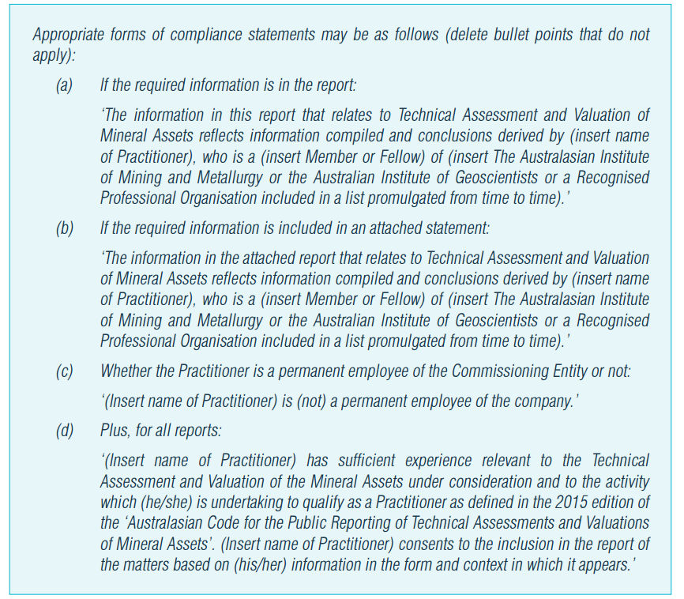
New requirements for declarations

Slide 46
SESSION 3
Question and answers.

Slide 47
Frequently asked questions
When is it acceptable to use Inferred Resources in income-based valuation methods?
What are the experience requirements of Specialists versus Competent Persons?
Is the VALMIN Code (2015) appropriate for International use?
What is the difference between a Specialist Report and an Independent Expert Report?
Valuation ranges – what is appropriate?
Further FAQs will be added following the Q&A sessions at each VALMIN Roadshow presentation.

Slide 48
Thank you!

